Slide 1



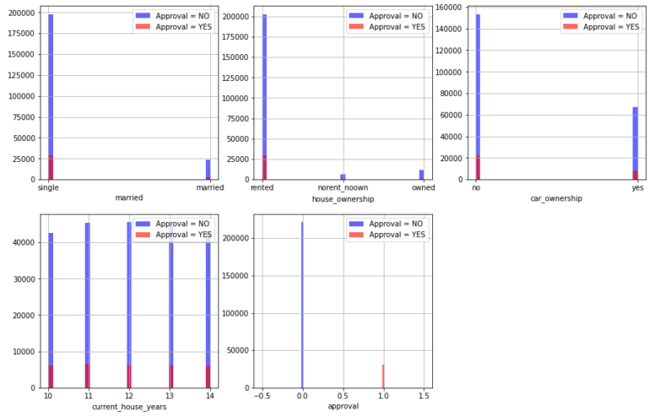
Credit Card Approval Detection
Program Feedback
Project Short Summary
I had an exceptional learning experience, all thanks to this program. The IBM mentor and the Edunet mentors have been extremely supportive, interactive with their infectious enthusiasm.
The hands on expert sessions on AI and the rest of the relevant topics have been delightful. I’m extremely grateful for this opportunity to Edunet and IBM.
Credit Card Approval Detection using Machine Learning using financial data. The Project is aims to derive useful insights from given financial data and detect Credit Card Approval.
Data Science and Machine Learning are used to assist the financial institutions with more powerful and robust machine leaning models which can help the admins identify the fraudulent transactions involved with the user’s credit card. Credit card companies must be capable of detecting credit card fraud transactions so as to detect fraudulent transactions of products that the customer did not purchase.
Ambika Ajai Singh
ambika.ajais@gmail.com
Final Project Outcome Screenshot
NSTI Prayagraj (Allahabad)
#skillsbuild

